Slide 1
Neural Network Programming
Mrinal Wahal
Research Park, IIT Madras

Slide 2
The Peculiar Case Against Mathematics

Slide 3
Introduction to
Machine Learning
Or so they say.

Slide 4
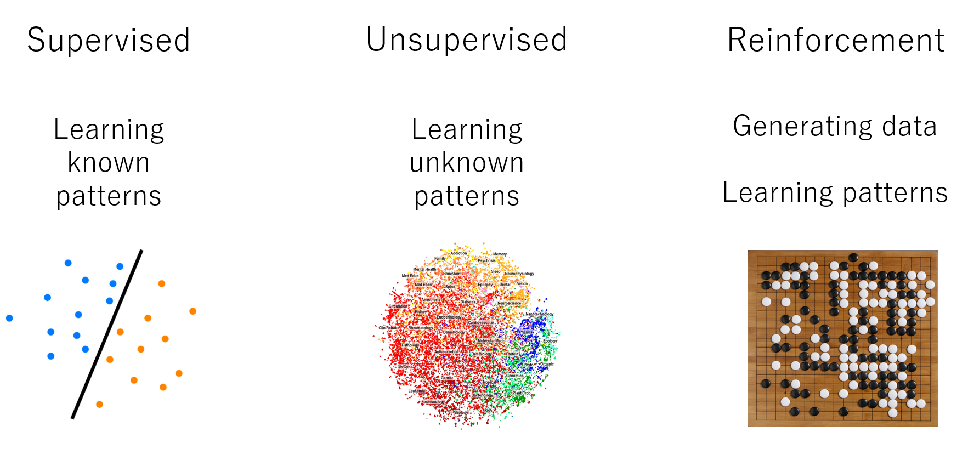

Slide 5
Explaining Neural Network programs to a 5 year old.
Okay, maybe a little older than that.

Slide 6
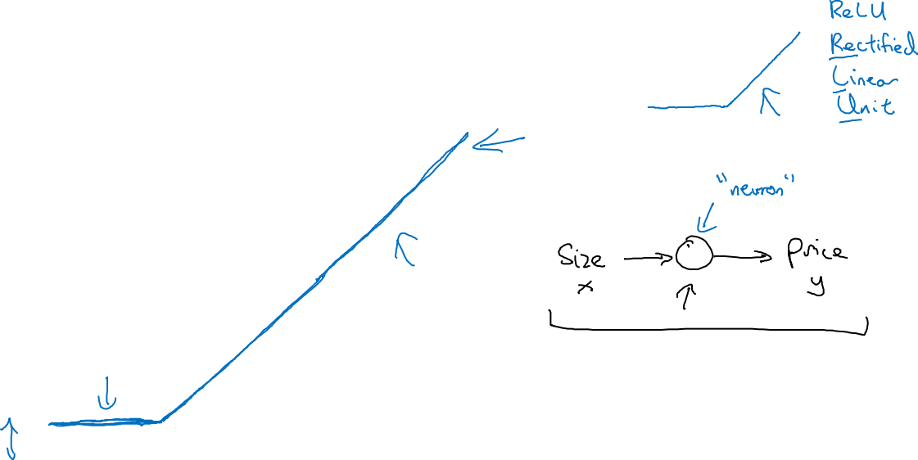
Housing Price Prediction
price
size of house

Slide 7
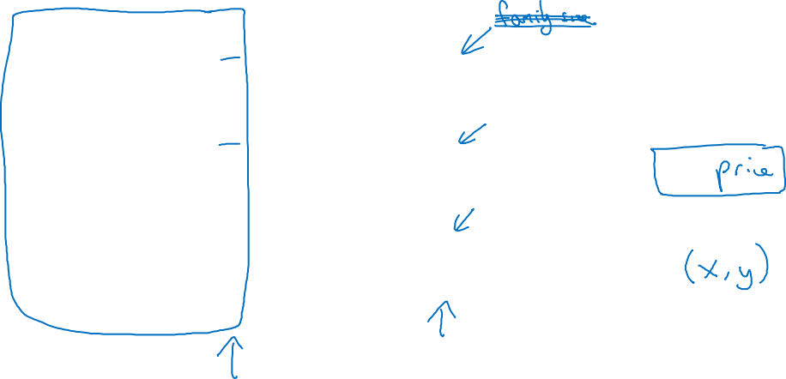
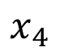
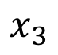
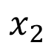
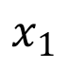
Housing Price Prediction
size
$$x_{1}$$
#bedrooms
$$x_{2}$$
y
zip code
$$x_{3}$$
wealth
$$x_{4}$$

Slide 8
XOR Function
In a Practical Simulation

Slide 9
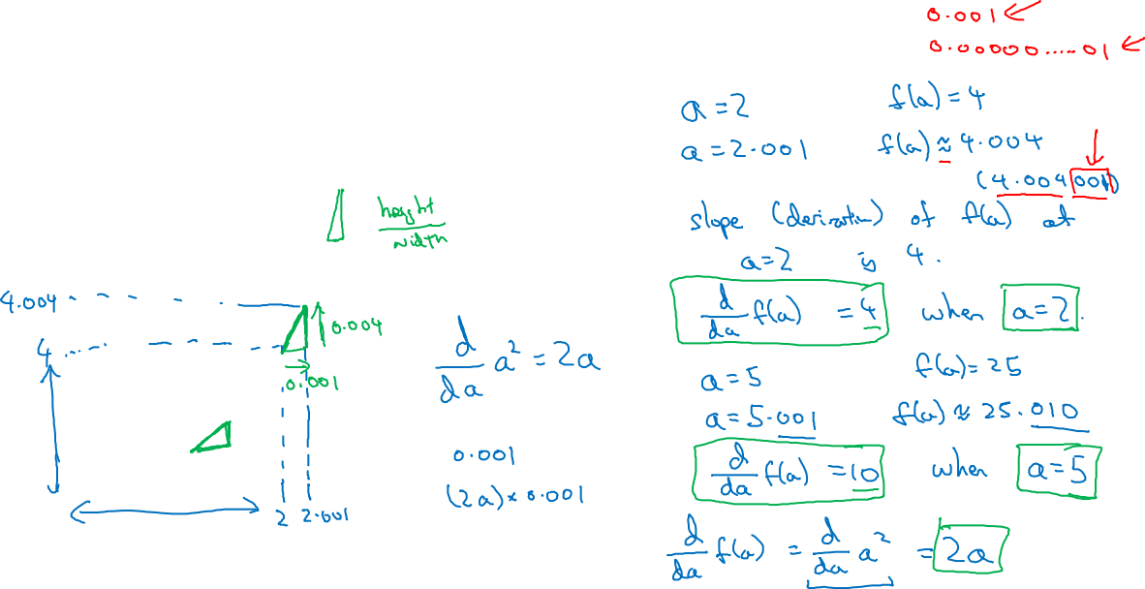
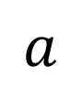
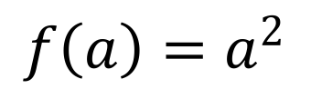
Intuition about derivatives
$$f\left(a\right)=a^{2}$$
$$a$$

Slide 10
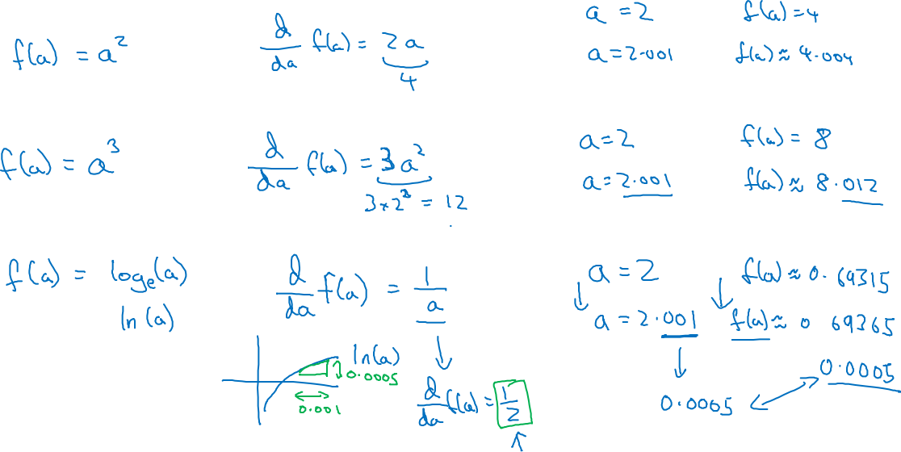

Slide 11
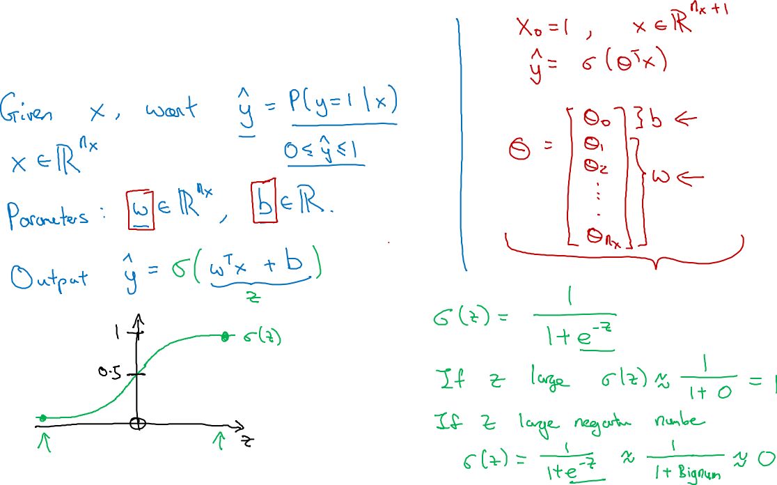
Logistic Regression

Slide 12
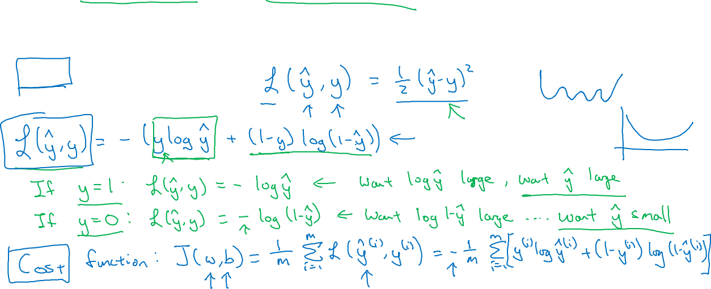
Logistic Regression cost function
$\hat{y} = σ\left(w^{T}x +b\right)$, where $σ\left(z \right)=\frac{1}{1+e^{−z}}$
Given $\left\{{(x}^{(1)},y^{(1)}\text{)}\text{,}\text{…}\text{,}{(x}^{(m)},y^{(m)}\text{)}\right\},$want ${\hat{y}}^{(i)}≈y^{\left(i\right)}$.
Loss (error) function:

Slide 13
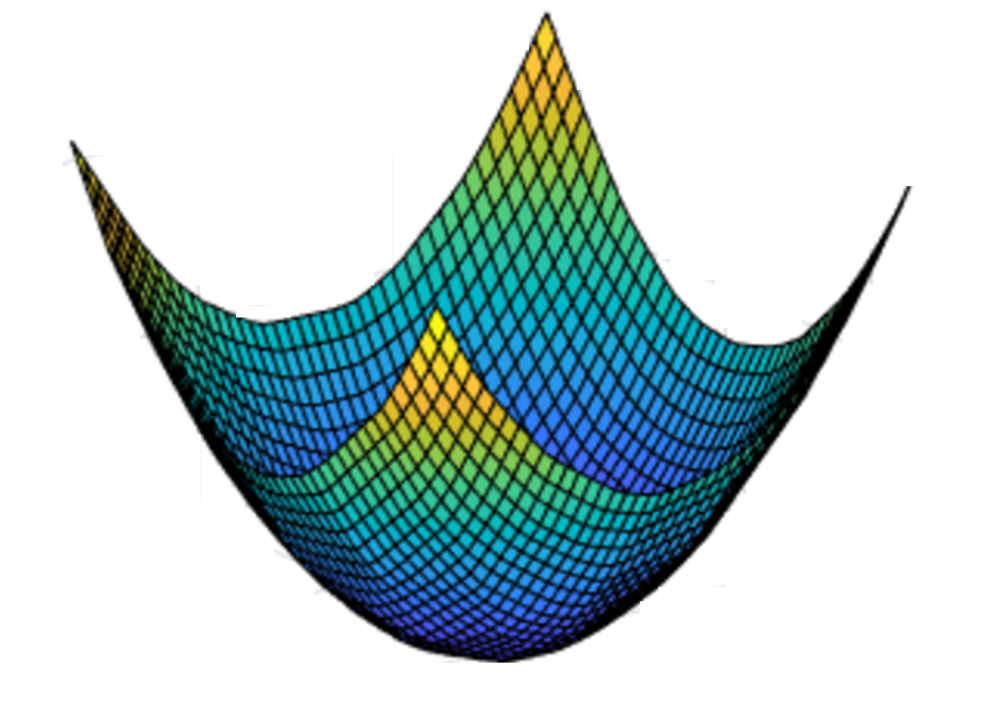

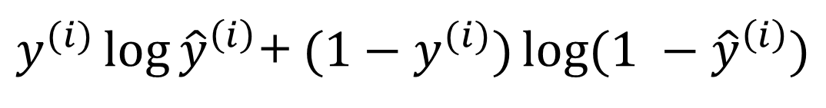
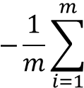
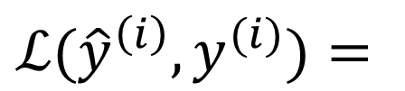
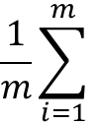
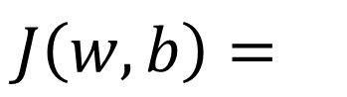


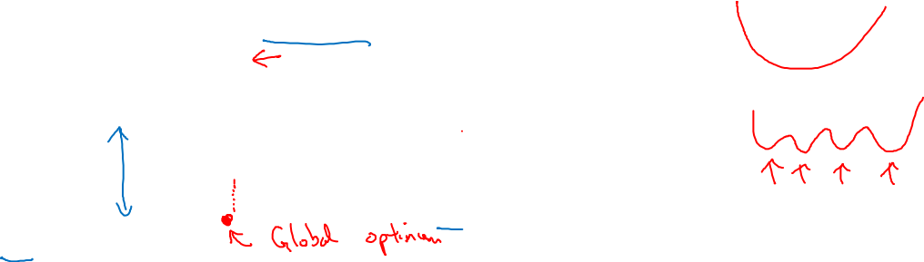

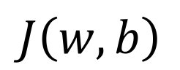
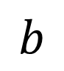
Gradient Descent
Recap: $\hat{y}= σ\left(w^{T}x+b\right)$, $σ\left(z\right)=\frac{1}{1+e^{−z}}$
$$\frac{1}{m}\sum_{i=1}^{m}{ }$$
$ℒ({\hat{y}}^{\left(i\right)},y^{(i)})$ $=$
$$−\frac{1}{m}\sum_{i=1}^{m}{ }$$
$$J\left(w,b\right)=$$
$y^{(i)}\log{{\hat{y}}^{\left(i\right)}}$+ $({1−y}^{(i)})\log{(1 −{\hat{y}}^{\left(i\right)})}$
Want to find $w,b$ that minimize $J\left(w,b\right)$
$$J\left(w,b\right)$$
$$b$$
$$w$$

Slide 14
Wait Dude. Go slow.
Back up... Do that Again !!!
Neural Network
Representation

Slide 15
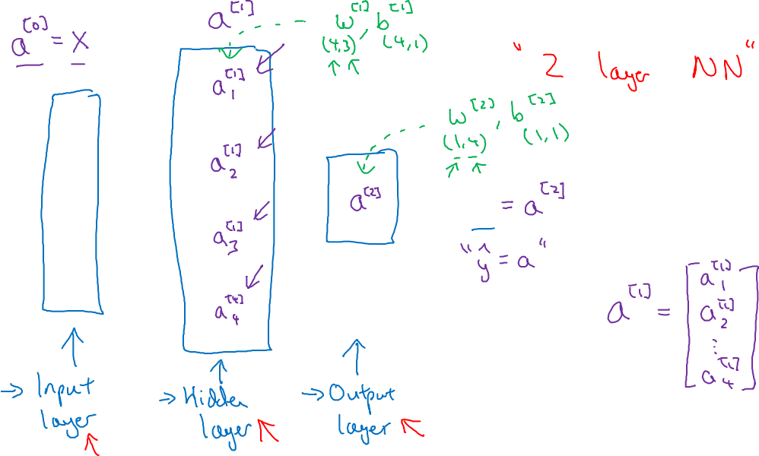
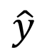
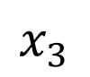
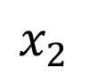
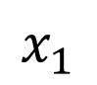
Neural Network Representation
$$x_{1}$$
$$x_{2}$$
$$\hat{y}$$
$$x_{3}$$

Slide 16
Let's Get this thing to work man !
Computing a
Neural Network’s
Output

Slide 17
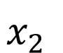
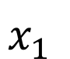
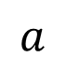

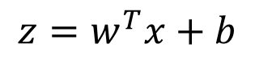

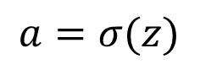

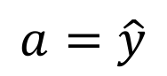
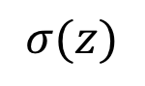
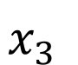
Neural Network Representation
$$x_{1}$$
$$x_{1}$$
$$x_{2}$$
$$σ(z)$$
$$a=\hat{y}$$
$$x_{2}$$
$$\hat{y}$$
$$w^{T}x+b$$
$$z$$
$$a$$
$$x_{3}$$
$$x_{3}$$
$$z=w^{T}x+b$$
$$a=σ(z)$$

Slide 18
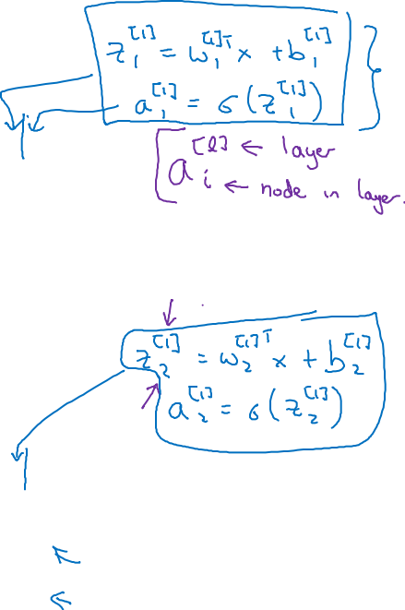

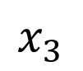
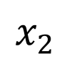
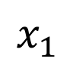

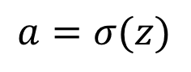
Neural Network Representation
$$x_{1}$$
$$x_{1}$$
$$x_{2}$$
$$σ(z)$$
$$a=\hat{y}$$
$$x_{2}$$
$$\hat{y}$$
$$w^{T}x+b$$
$$z$$
$$a$$
$$x_{3}$$
$$x_{3}$$
$$z=w^{T}x+b$$
$$x_{1}$$
$$a=σ(z)$$
$$x_{2}$$
$$\hat{y}$$
$$x_{3}$$

Slide 19
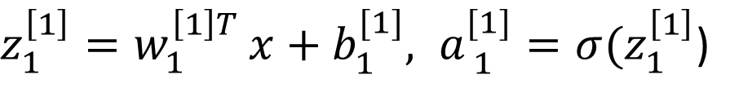
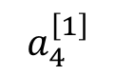
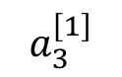
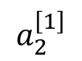
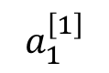
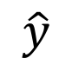
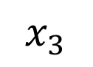
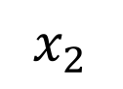
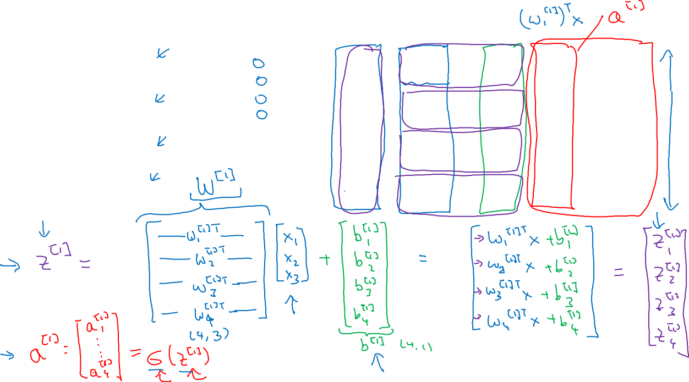
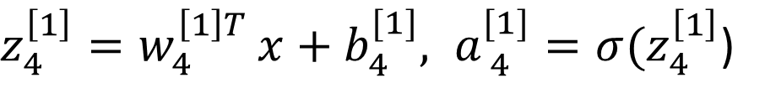



Neural Network Representation
$$a_{1}^{\left[1\right]}$$
$z_{1}^{\left[1\right]}=w_{1}^{{\left[1\right]T}^{ }}x+b_{1}^{[1]}, a_{ 1}^{[1]}=σ(z_{1}^{\left[1\right]}$)
$$x_{1}$$
$$a_{2}^{\left[1\right]}$$
$z_{2}^{\left[1\right]}=w_{2}^{{\left[1\right]T}^{ }}x+b_{2}^{[1]}, a_{ 2}^{[1]}=σ(z_{2}^{\left[1\right]}$)
$$x_{2}$$
$$\hat{y}$$
$$a_{3}^{\left[1\right]}$$
$z_{3}^{\left[1\right]}=w_{3}^{{\left[1\right]T}^{ }}x+b_{3}^{[1]}, a_{ 3}^{[1]}=σ(z_{3}^{\left[1\right]}$)
$$x_{3}$$
$$a_{4}^{\left[1\right]}$$
$z_{4}^{\left[1\right]}=w_{4}^{{\left[1\right]T}^{ }}x+b_{4}^{[1]}, a_{ 4}^{[1]}=σ(z_{4}^{\left[1\right]}$)

Slide 20





Neural Network Representation learning
$$a_{1}^{\left[1\right]}$$
Given input x:
$$x_{1}$$
$$a_{2}^{\left[1\right]}$$
$$z^{\left[1\right]}=W^{\left[1\right]}x+b^{\left[1\right]}$$
$$x_{2}$$
$$\hat{y}$$
$$a_{3}^{\left[1\right]}$$
$$x_{3}$$
$$a^{\left[1\right]}=σ(z^{\left[1\right]})$$
$$a_{4}^{\left[1\right]}$$
$$z^{\left[2\right]}=W^{\left[2\right]}a^{\left[1\right]}+b^{\left[2\right]}$$
$$a^{\left[2\right]}=σ(z^{\left[2\right]})$$

Slide 21
Forward Propagation Implementation in Python
[ Once Again ]

Slide 22



Logistic regression recap
$$z= w^{T}x+b$$
$$\hat{y}=a= σ(z)$$
$$ℒ\left(a,y\right)=−(y\log{(a)+(1−y)\log{(1−a))}}$$

Slide 23








Logistic regression derivatives
$$x_{1}$$
$$w_{1}$$
$$x_{2}$$
$$w_{2}$$
b

Slide 24

Logistic regression on m examples

Slide 25
What the Fuss of
Activation functions ?

Slide 26



Pros and cons of activation functions
a
a
x
z
$$a= \frac{1}{1+e^{−z}}$$
sigmoid:
a
a
z
z

Slide 27
Little More Maths
Derivatives of
activation functions

Slide 28


Sigmoid activation function
a
$$g(z)= \frac{1}{1+e^{−z}}$$
z

Slide 29


Tanh activation function
a
$$g(z)=tanh(z){ }$$
z

Slide 30

ReLU and Leaky ReLU
a
a
z
z
ReLU
Leaky ReLU

Slide 31
Deep Neural Networks
Why deep
representations?
[ Finally Something Deep ]

Slide 32





Intuition about deep representation
$$\hat{y}$$

Slide 33
Back to Basics of Neural Network Programming
Vectorization

Slide 34


What is vectorization?

Slide 35

Neural network programming guideline
Whenever possible, avoid explicit for-loops.

Slide 36


Vectors and matrix valued functions
Say you need to apply the exponential operation on every element of a matrix/vector.
$$v= \left[\begin{matrix}v_{1} \\ ⋮ \\ v_{n}\end{matrix}\right]$$
u = np.zeros((n,1))
for i in range(n):
u[i]=math.exp(v[i])

Slide 37
One hidden layer
Neural Network
Random Initialization

Slide 38







What happens if you initialize weights to zero?
$$x_{1}$$
$$a_{1}^{[1]}$$
$$a_{1}^{[2]}$$
$$\hat{y}$$
$$x_{2}$$
$$a_{2}^{[1]}$$

Slide 39

Random initialization
$$x_{1}$$
$$a_{1}^{[1]}$$
$$a_{1}^{[2]}$$
$$\hat{y}$$
$$x_{2}$$
$$a_{2}^{[1]}$$

Slide 40
Answering the First Big Question.
How do I get my matrix
dimensions right ?

Slide 41





Parameters $W^{[l]}$ and $b^{[l]}$
$$x_{1}$$
$$\hat{y}$$
$$x_{2}$$

Slide 42


Vectorized implementation
$$x_{1}$$
$$\hat{y}$$
$$x_{2}$$

Slide 43
[ Let's Add Some Typical Boring Lecture Advice ]

Slide 44
But But... what just happened ???... wait man !!! Hey... DUDE ?!
What does this
have to do with
the brain?

Slide 45













Forward and backward propagation
$$Z^{[1]}=W^{[1]}X+b^{[1]}$$
$${dZ}^{[L]}=A^{[L]}−Y$$
$$A^{[1]}=g^{\left[1\right]}(Z^{\left[1\right]})$$
$$dW^{[L]}=\frac{1}{m}dZ^{\left[L\right]}A^{{\left[L\right]}^{T}}$$
$$Z^{[2]}=W^{[2]}A^{[1]}+b^{[2]}$$
$$db^{[L]}=\frac{1}{m}np. sum(dZ^{\left[L\right]},axis=1, keepdims=True)$$
$$A^{[2]}=g^{\left[2\right]}(Z^{\left[2\right]})$$
…
$${dZ}^{[L−1]}=dW^{{\left[L\right]}^{T}}dZ^{\left[L\right]}{g^{′}}^{\left[L\right]}(Z^{\left[L−1\right]})$$
$$A^{[L]}=g^{\left[L\right]}\left(Z^{\left[L\right]}\right)=\hat{Y}$$
…
$${dZ}^{[1]}=dW^{{\left[L\right]}^{T}}dZ^{\left[2\right]}{g^{′}}^{\left[1\right]}(Z^{\left[1\right]})$$
$$dW^{[1]}=\frac{1}{m}dZ^{\left[1\right]}A^{{\left[1\right]}^{T}}$$
$$db^{[1]}=\frac{1}{m}np. sum(dZ^{\left[1\right]},axis=1, keepdims=True)$$

Slide 46

Binary Classification
1 (cat) vs 0 (non cat)
Blue
Green
Red

Slide 47
Nerd Stuff Alert !
Parameters vs
Hyperparameters

Slide 48

What are hyperparameters?
Parameters: $W^{\left[1\right]} ,{ b}^{\left[1\right] }, W^{\left[2\right]} ,b^{\left[2\right] },W^{\left[3\right] }, b^{\left[3\right] }…$

Slide 49


Applied deep learning is a very empirical process
Idea
cost $J$
Experiment
Code
# of iterations

Slide 50
Heavy Applications of Deep Learning
" Show me real life applications of this stuff."

Slide 51
Project Demo
"Enough Talk. Show me the how it's actually done."

Slide 52
Next-Gen Research Scopes
" If it's already advanced how we will progress with this futher ? "
Artificial Intuition
Artificial Immune Systems
Advanced Self-Driving Cars (Computer Vision)
Imaging Human Thoughts

Slide 53
Resources
www.Gitlab.com/Wahal
MrinalWahal@gmail.com
91 + 9560892906
PDFs
Keras
Python/R/Matlab
Pre-Written Codes

Slide 54
" In foreign sand, your knowledge is your rich possession. In the battlefield, your practical skills are your rich possession. Inside home, your wife/husband is your rich possession. On the death bed, the most efficacious medicine is your rich possession. But throughout life and beyond, your Dharma is your Kohinoor. "
~ Chanakya

